Slide 1
Learning Management System (LMS)
A Full-Stack Web Application using ASP.NET Core & Angular
By Shalini Thakur
Date:07/01/26

Slide 2
Project Overview
Objective: To develop a centralized Learning Management System that allows admins to manage users and approvals, instructors to create and manage courses and assignments, and students to enroll in courses, submit assignments, and track learning progress through dashboards and reports.
Technology Stack: ASP.NET Core Web API, Angular, SQL Server, Entity Framework Core, LINQ, JWT Authentication

Slide 3
Problem Statement
Educational institutions and training organizations often rely on multiple disconnected systems to manage users, courses, assignments, and progress, resulting in inefficient workflows, lack of transparency, and poor learning experience.
Key challenges:
Manual and unstructured course and user management
No clear approval workflow for users and courses
Difficulty tracking student enrollments and learning progress
Limited visibility into assignments, submissions, and performance
Absence of centralized dashboards and analytical reports

Slide 4
Solution & Key Features
Feature 1 – Role-Based User Management
Admin-managed user approval system with role-based access control for Admin, Instructor, and Student using JWT authentication.
Feature 2 – Course & Content Management
Instructors can create courses with modules and lessons and submit them for admin approval before publishing to students.
Feature 3 – Enrollment & Assignment Tracking
Students enroll in approved courses, submit assignments, and instructors can review and grade submissions with proper status tracking.
Feature 4 – Dashboards & LINQ-Based Reports
Dynamic dashboards and analytical reports generated using LINQ for enrollments, assignment submissions, and student progress tracking.

Slide 5
Technology Stack
🎯 Backend
⚡ Frontend
ASP.NET Core Web API with Entity Framework Core and LINQ to implement secure RESTful services, business logic, and reporting.
Angular with TypeScript and Angular Material to build a responsive, role-based user interface with reactive forms.
🔒 Roles
📊 Database
SQL Server with a normalized relational schema to store users, courses, enrollments, assignments, and progress data.
Admin,Student,Instructor

Slide 6
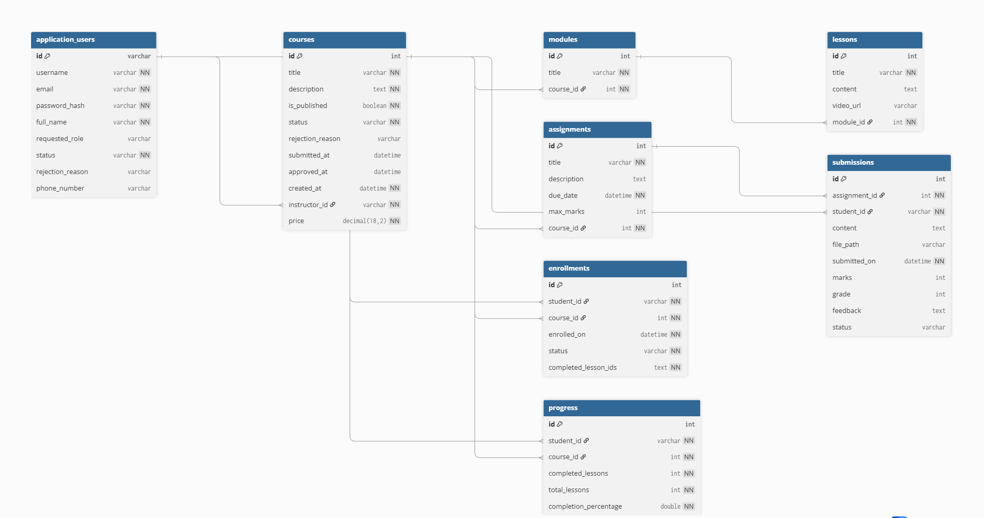
ER Diagram

Slide 7
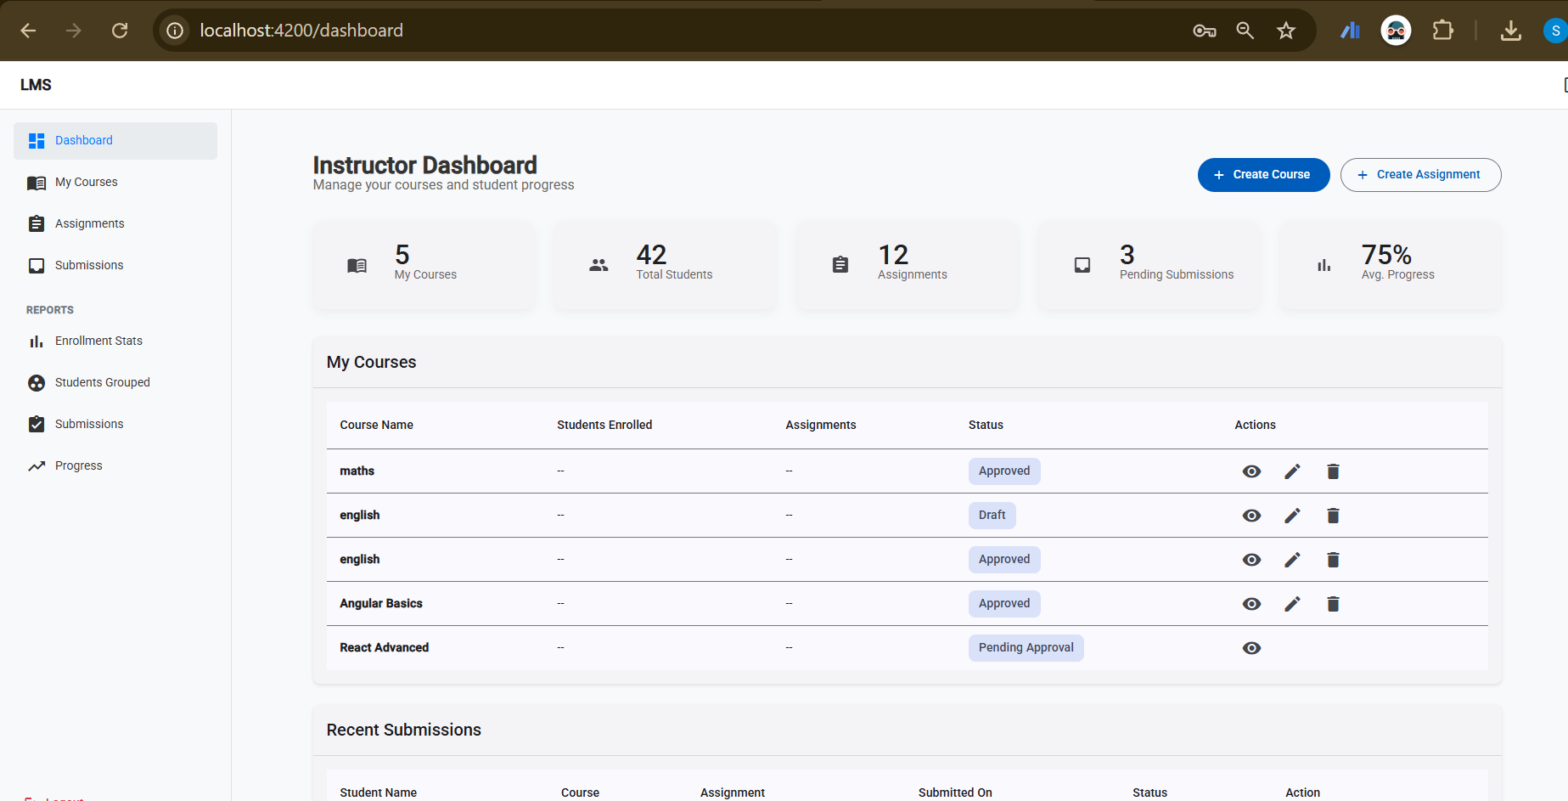
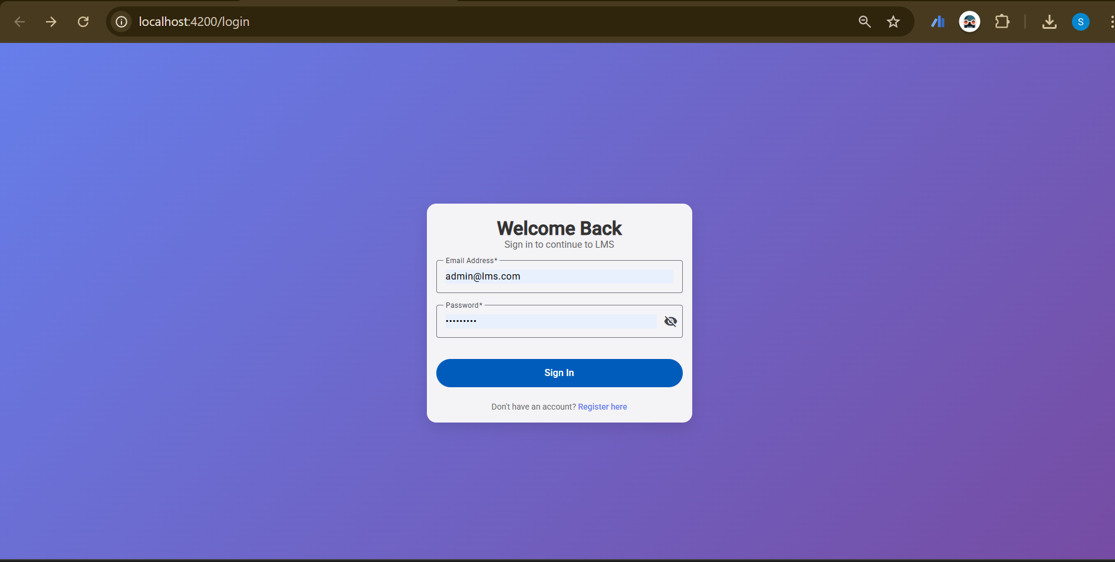
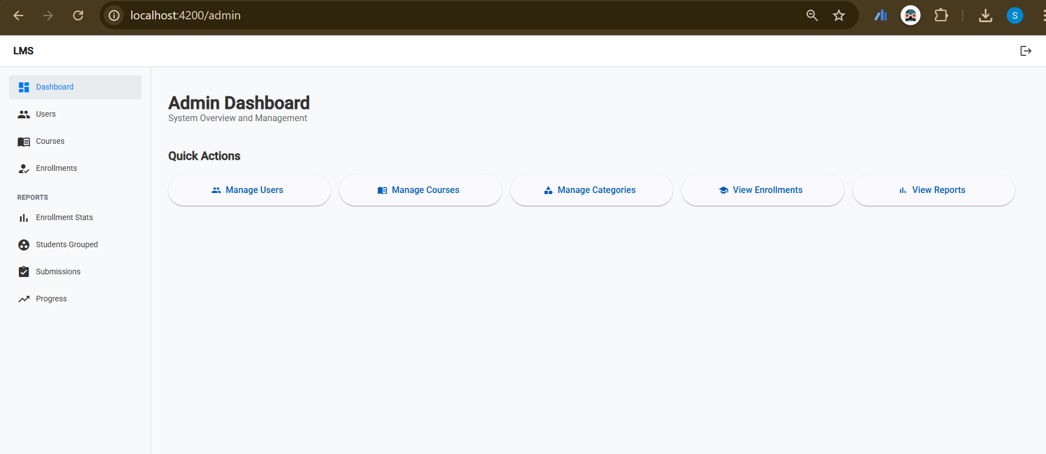
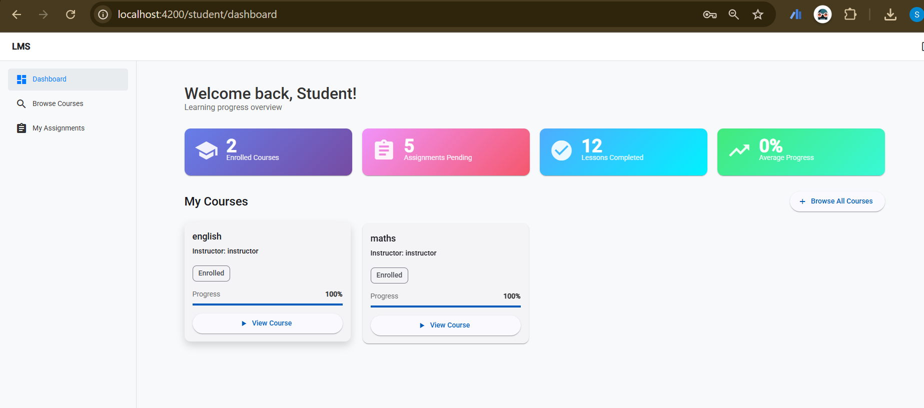
Dashboard Screen

Slide 8
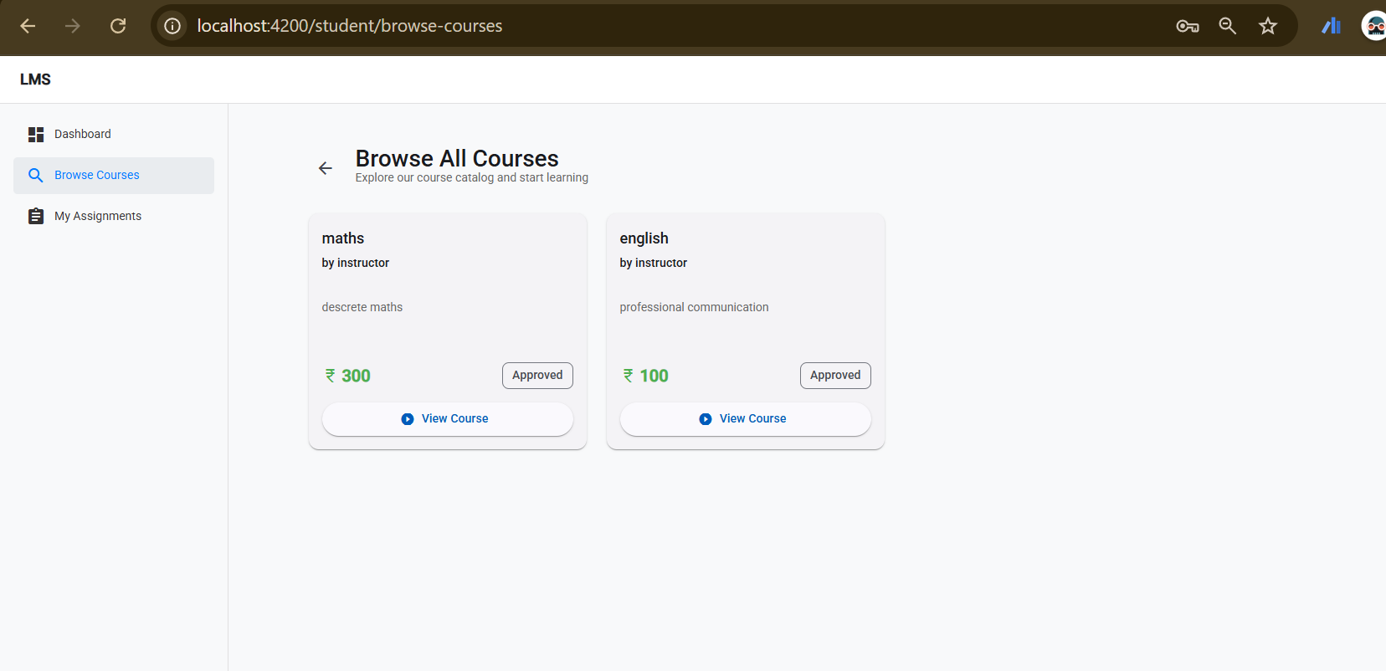
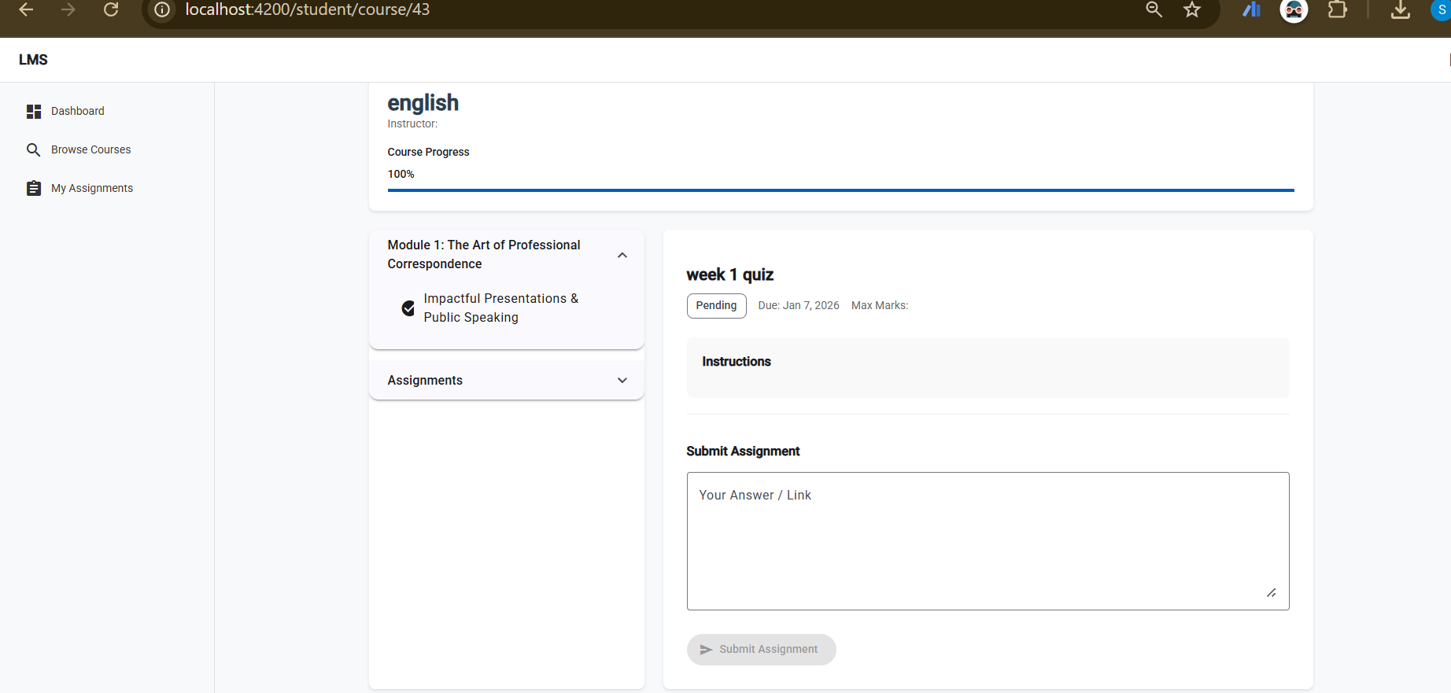
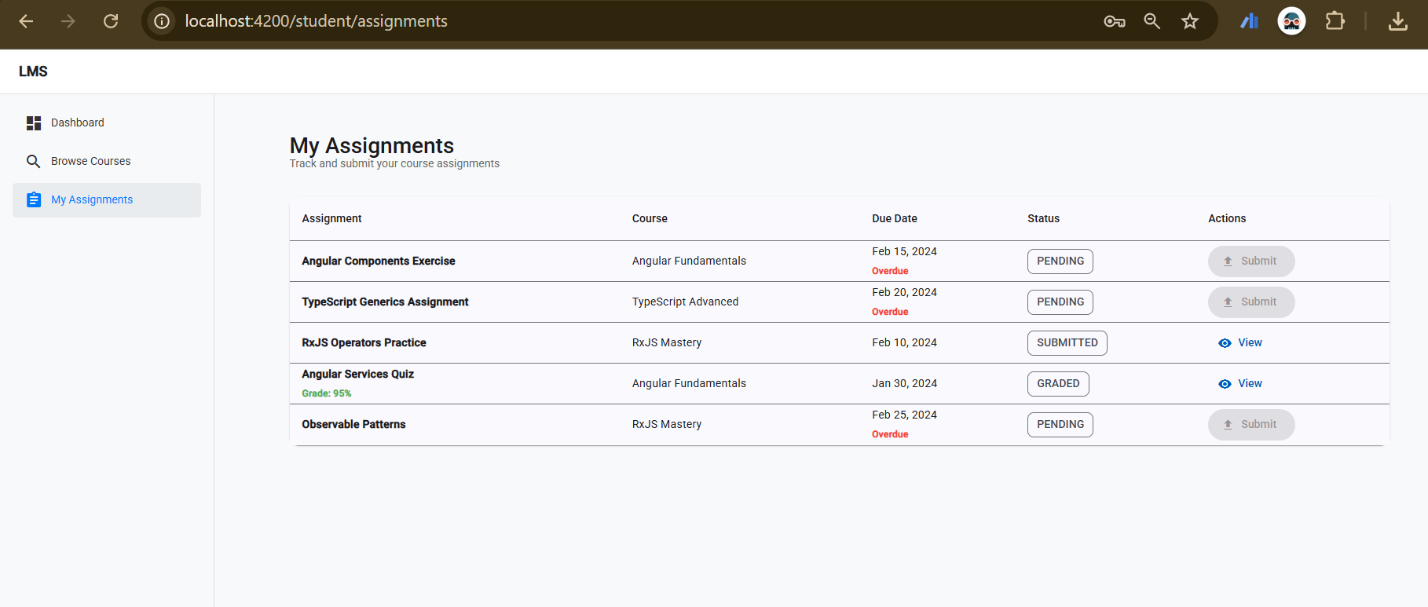
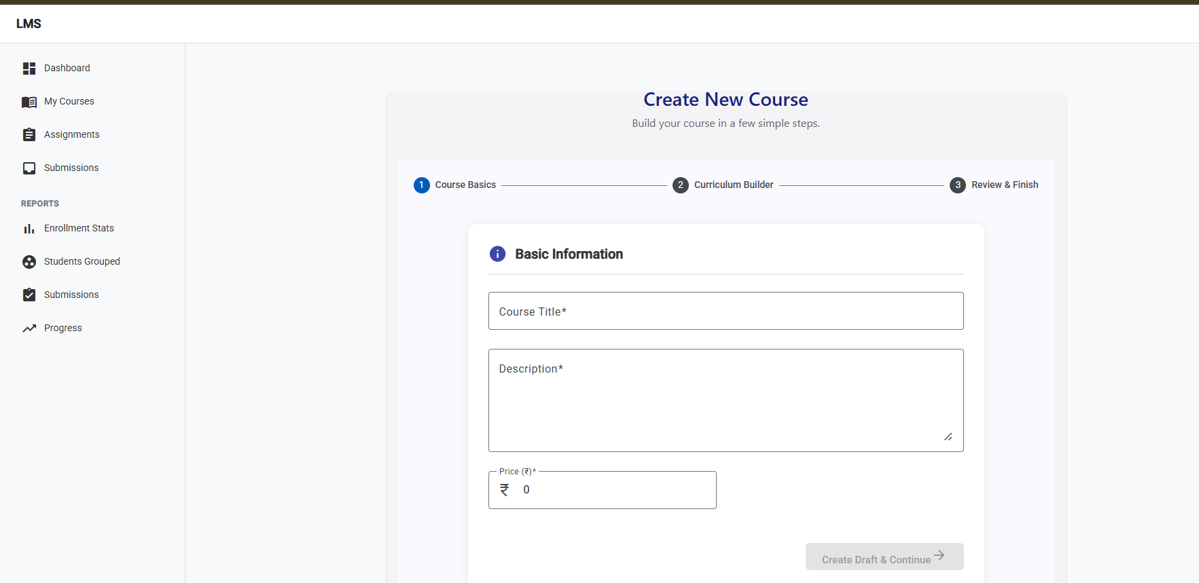
User Management Screen

Slide 9
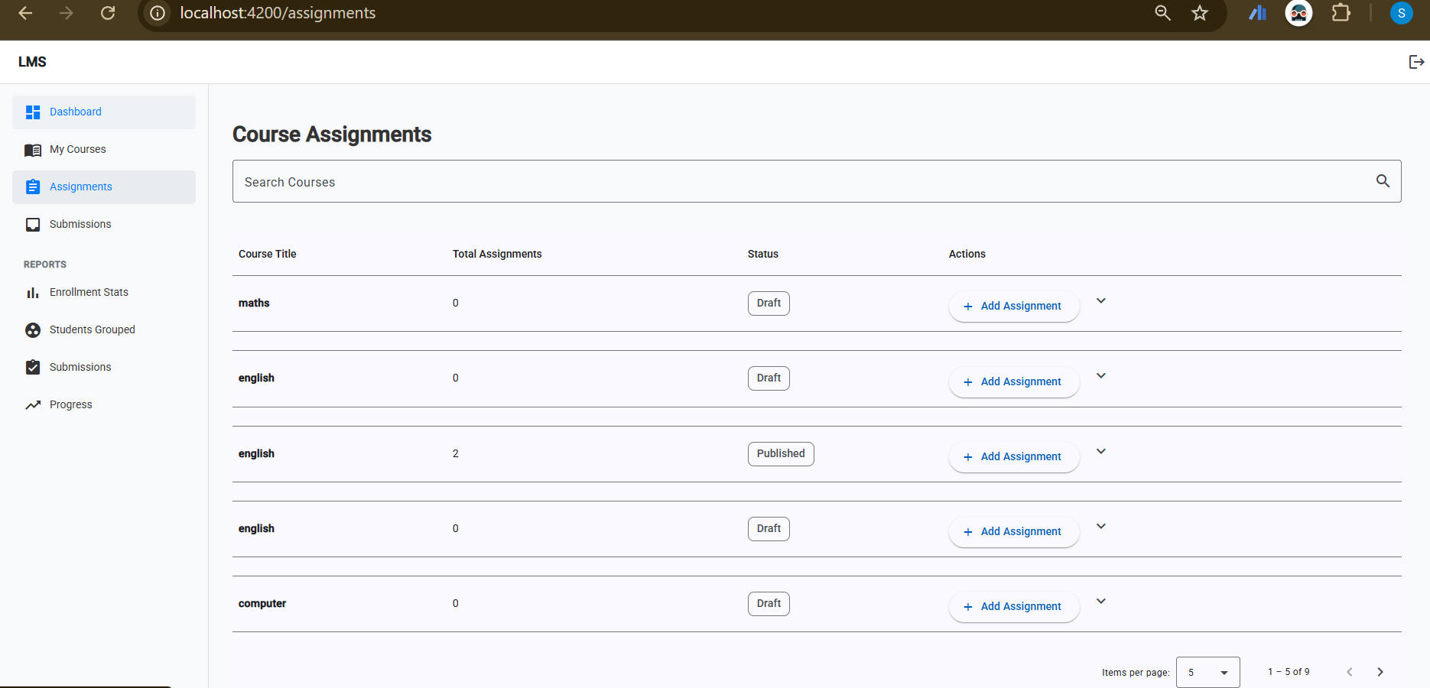
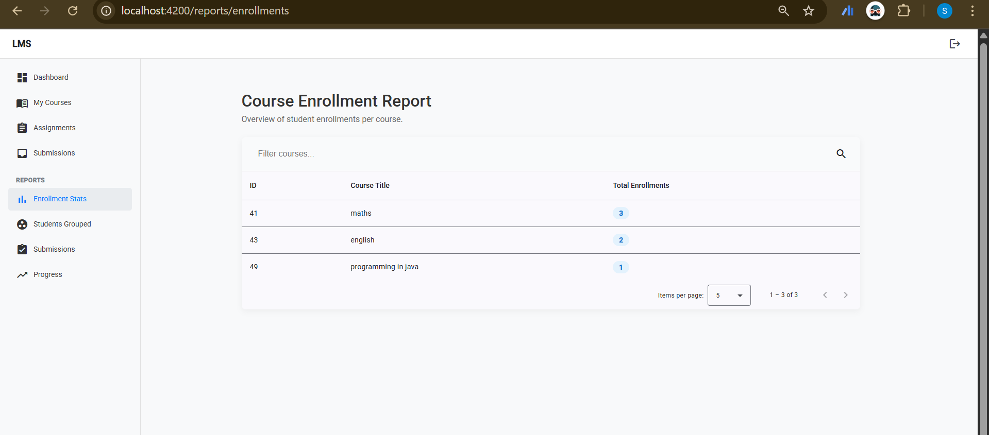
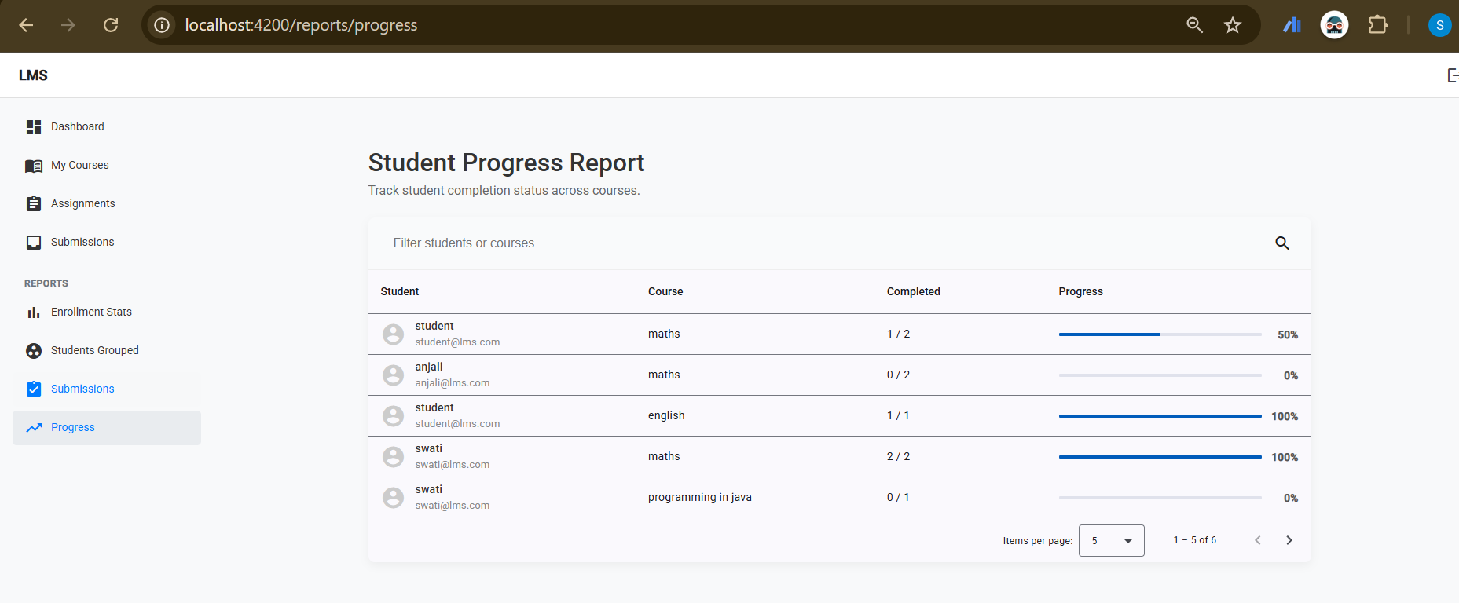
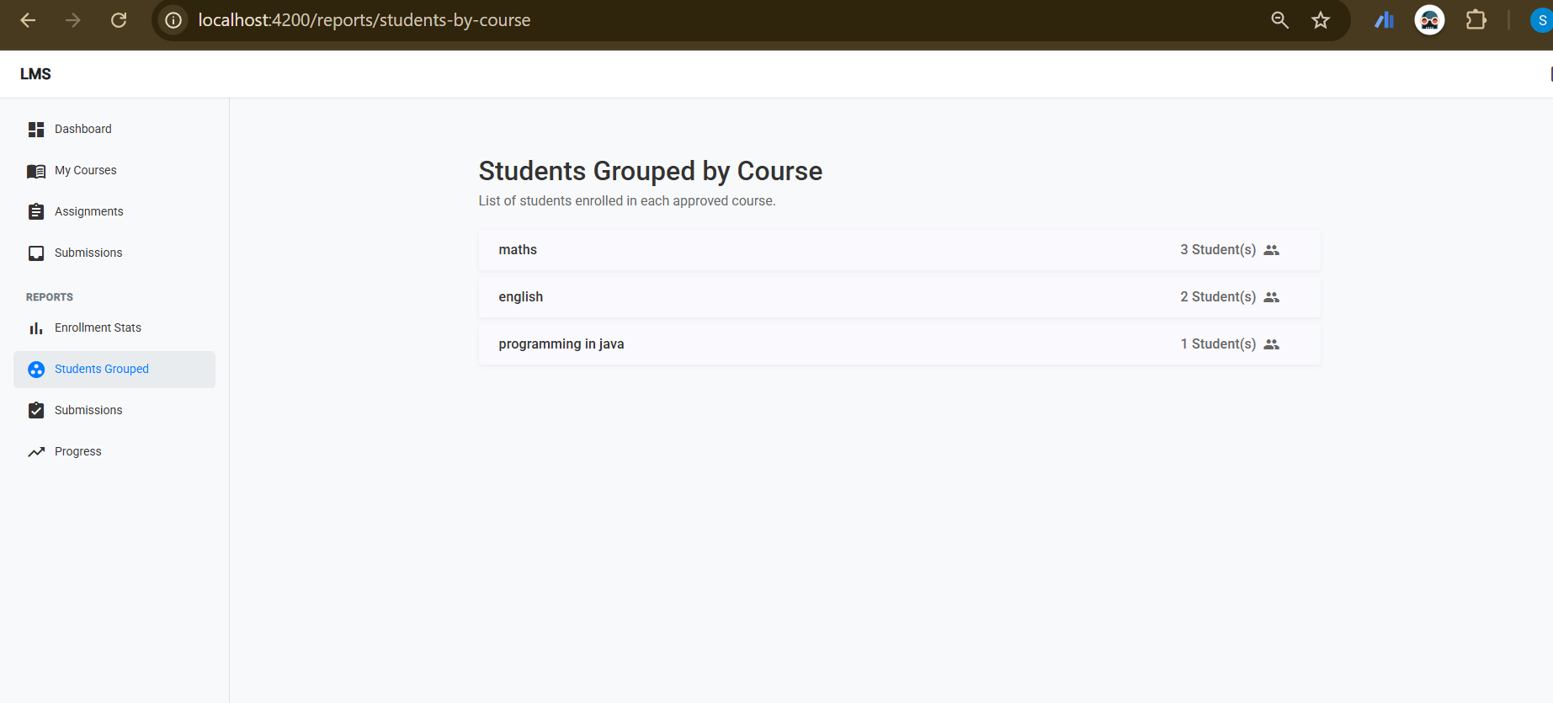
Reports & Analytics

Slide 10
Live Demonstration
https://drive.google.com/drive/home?dmr=1&ec=wgc-drive-globalnav-goto

